Slide 1

Advanced topic: Geometry LOD
COMP4451 Game Programming

Slide 2
Outline
Static Geometry LOD
Fixed LOD sequences
View-dependent geometry LOD
Frontiers on LOD trees

Slide 3
Progressive Meshes
Hugues Hoppe

Slide 4

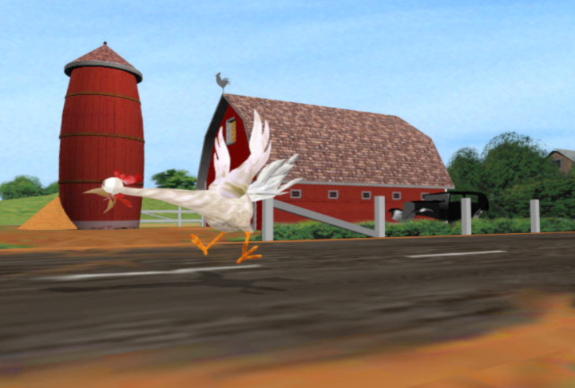
Complex meshes
43,000 faces
lots of faces!
Challenges:
- rendering
- storage
- transmission
Notes:
(There is a growing expectation for realism in computer graphics, and as a result we are seeing more and more highly complex models.)
The motivation in this talk is very similar to that of the previous talk.
Geometric models are becoming very complex; they are often represented as complex meshes consisting of tens of thousands of faces.
And, computer graphics scenes are often composed of many such meshes, so the overall complexity can be huge.
This presents several challenges, because of limitations in rendering performance, storage capacities, and transmission bandwidths.

Slide 5
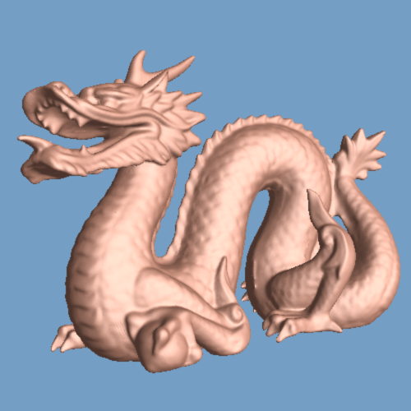
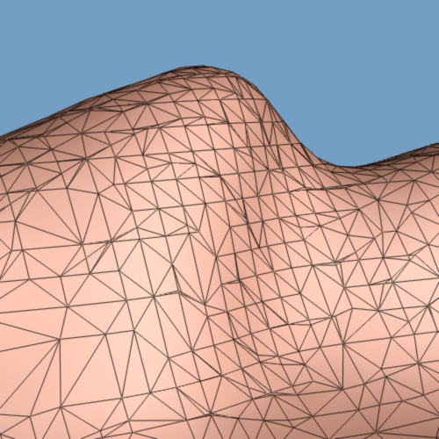
Rendering complex meshes
860,000 faces!
V
F
Notes:
For the past couple of years, I’ve been interested in the representation of complex geometric models, and in particular, triangular meshes.
For instance, this mesh was obtained using a 3D scanner at Stanford University; it has lots of geometric detail, but consists of over 860,000 faces.
<click> As shown in this close-up view, a mesh consists of a set of triangular faces pasted together along their edges and meeting at a common set of vertices. A mesh is typically represented as an array of vertices, and an array of faces.
In this talk, I’ll be specifically addressing the problem of rendering such complex meshes.

Slide 6
Contributions
New mesh simplification procedure
preserve appearance (colors, normals, …)
New representation: progressive mesh
lossless
continuous-resolution
efficient
progressive transmission
Notes:
In addressing these problems, this paper has two major contributions:
First, it introduces a new mesh simplification procedure.
Unlike previous methods, this procedure seeks to preserve not just the geometry of the model, but more generally its overall appearance. So it tries to capture the model’s colors, normals, and other appearance attributes.
Unfortunately, I won’t have much time to present the details of this procedure.
Instead, I’ll focus on the second, more important contribution, which is that this simplification procedure brings about a new format for representing meshes, which I call the progressive mesh representation.
This new multiresolution representation has a number of nice properties. As I’ll demonstrate in this talk,
it is lossless as no information is lost in representing a mesh this way,
it captures a continuous-resolution family of approximations,
it is efficient in both time and space,
and it can be transmitted progressively.

Slide 7
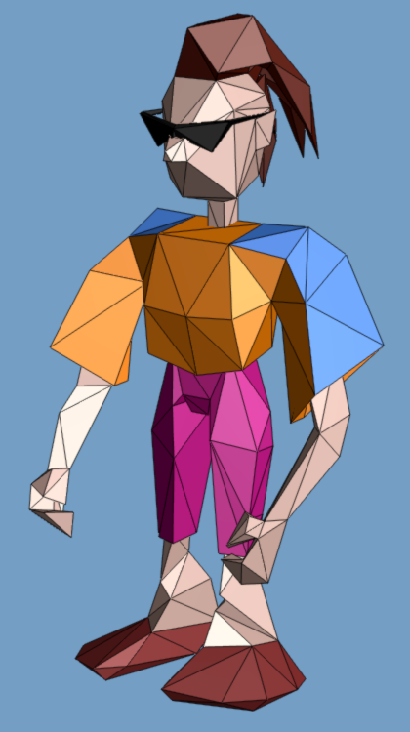
Traditional mesh representation
mesh M
V
F
Vertex 1 x₁ y₁ z₁
Vertex 2 x₂ y₂ z₂
…
Face 1 2 3
Face 3 2 4
Face 4 2 7
…
(appearance attributes: normals, colors, textures, ...)
Notes:
As shown here, a mesh consists of a set of triangular faces pasted together along their edges and meeting at a common set of vertices
traditional representation is… a set of vertices containing xyz coordinates, and a set of faces containing indices refering back to the vertices.
Besides geometry, other appearance attributes are often present in a mesh… these are associated with the vertices and faces of the mesh.

Slide 8
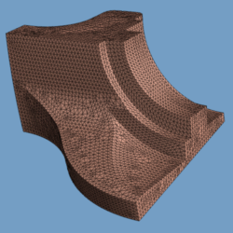
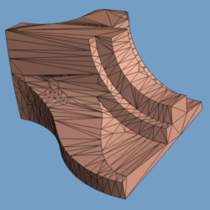
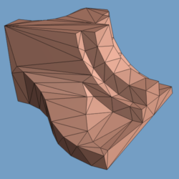
Mesh simplification
13,000
[Schroeder-etal92]
[Turk92]
[Hoppe-etal93]
[Rossignac-Borrel93]
[Cohen-etal96]
...
1,000
200
?
Notes:
Several methods have been developed to simplify meshes. I’ve listed a number of these on this slide.
The goal of these methods is to reduce the number of faces in the mesh while attempting to preserve its original shape.
These methods typically contain some complexity parameters that can be varied to obtain several meshes with different trade-off’s of size and accuracy.
However this only yields a discrete set of meshes. Ideally we would want to capture a continuum that spans all these meshes.

Slide 9
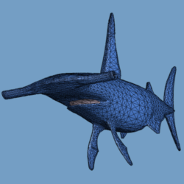
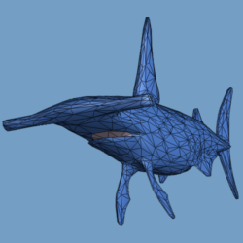
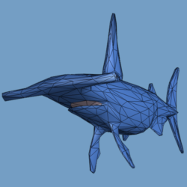
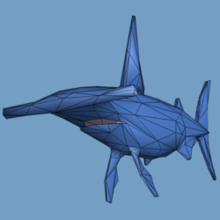
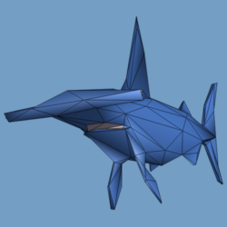
Level-of-detail (LOD)
[Clark76]
[Funkhouser93]
distance
from viewer?
close
far
10,000
2,000
1,000
500
250
Concern: transitions may “pop” → would like smooth LOD
Notes:
These simplified meshes are often used in the context of level-of-detail.
The idea is to use a fully-detailed mesh when the model is close to the viewer, and to substitute coarser and coarser approximations as the object recedes away from the viewer.
<click> One concern with this approach is that instantaneous switching between the various meshes may result in a “popping” perceptible to the user.
Therefore we would like to have a smoother level-of-detail representation.

Slide 10
New mesh simplification procedure
Idea: apply sequence of edge collapses:
ecol(v_{s} ,v_{t} , v_{s} )
’
v_{t}
v_{l}
v_{r}
v_{l}
v_{s}
v_{r}
’
v_{s}
(optimization)
Notes:
I’ll now introduce our new simplification procedure.
Conceptually it’s extremely simple.
It simplifies the original mesh by applying to it a sequence of edge collapse transformations.
As shown here, an edge collapse is a local mesh operation that takes two adjacent vertices of the mesh and unifies them into one, removing two faces in the process.
Note that the position of the new unified vertex can be arbitrary.
<click> Of course, there is an optimization procedure for selecting which edges to collapse and what geometry to assign to the new vertices, and I’ll return to that issue a little later.
<click><35mm> (copy slide)

Slide 11
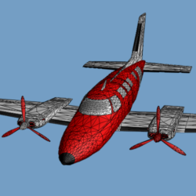
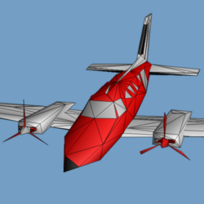
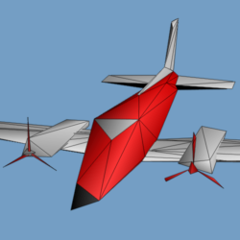
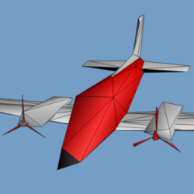
Simplification process
13,546
500
152
150
^
M=M^{n}
M¹⁷⁵
M¹
M⁰
ecol_{n-1}
ecol_{i}
ecol₀
Notes:
Thus the simplification starts with the original mesh, denoted M^n, and through a sequence of edge collapse transformations, simplifies it down to a very coarse base mesh, M^0.
<click> You can see the effect of the very last edge collapse transforming M^1 into M^0; it removes the last window from the airplane.

Slide 12
Invertible!
Vertex split transformation:
attributes
vspl(v_{s} ,v_{l} ,v_{r} , v_{s} ,v_{t} ,…)
’
’
’
v_{t}
v_{l}
v_{s}
v_{r}
v_{l}
v_{r}
v_{s}
’
Notes:
A key observation is that the edge collapse transformation is invertible.
I call its inverse a “vertex split”.
This operation takes as parameters a vertex v_s along with two of its neighbors v_l and v_r. It splits v_s into two vertices, creating two new faces in the process.
The vertex split record also requires the positions of the two split vertices as well as other appearance attributes associated with the new neighborhood.
<click><35mm> (copy slide)

Slide 13
Reconstruction process
150
152
500
13,546
^
^
M⁰
M¹
M¹⁷⁵
M^{n}=M
M⁰
M^{n}=M
vspl₀
… vspl_{i} …
vspl₀
… vspl_{i} …
vspl_{n-1}
vspl_{n-1}
progressive mesh (PM) representation
Notes:
We can therefore flip the previous diagram, starting with the base mesh M^0, and apply to it a sequence of vertex split transformations
<click> the first vertex split introduces one vertex and two faces.
<click> subsequent vertex splits recover more and more detail.
<click> after all vertex splits have been applied, the original mesh M^n is recovered exactly.
Therefore, the base mesh M^0 together with the sequence of vertex split records <click> forms an alternate representation for the mesh. This is what I refer to as the progressive mesh representation.
<click> It is equivalent to knowing the original mesh. It just expresses it in a different format.
<click><35mm>(copy slide)
<click><video> Here is a quick video demonstrating the simplification process. The original mesh has 1600 faces; it is simplified down to about 20 faces.
Now here is an illustration of the reconstruction process.
(you’ll have to trust me that I’m not playing the tape backwards :-) )

Slide 14
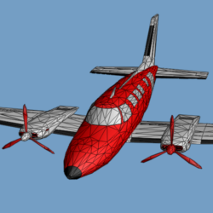
Application: Continuous-resolution LOD
From PM, extract M^{i} of any desired complexity.
3,478 faces?
M⁰
vspl₀
vspl₁
vspl_{i-1}
vspl_{n-1}
3,478
M^{i}
^
M⁰
M^{n}=M
M^{i}
Notes:
I’ll now discuss several advantages of this progressive mesh representation.
First, it is a continuous-resolution representation.
What I mean by this is that from it one can recover approximating meshes of any desired complexity.
This is achieved by applying to the base mesh a prefix of the vertex split sequence.
<click> So if one wants to recover a mesh with 3,478 faces,
<click> it can be retrieved very efficiently.
<click> In effect, this defines a continuous family of approximating meshes (from the base mesh M^0 to the original mesh M^n), and we can interate through these meshes by applying edge collapses and vertex splits.
<click> In fact, this can be done very efficiently. On a fast Pentium, we obtain a reconstruction rate of about 100,000 faces/sec, and a simplification rate of about 200,000 faces/sec.
<click><video> I’ll now show two examples demonstrating this. All these videos were recorded in real-time on an SGI Indigo2 workstation. In fact, the bottleneck in most of these examples is rendering time.

Slide 15
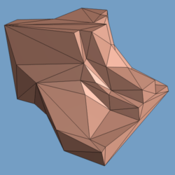
Property: Vertex correspondence
M^{f}
M^{f-1}
M^{f-2}
M^{c}
M^{n}
v₁
v₁
v₁
v₁
M⁰
v₂
v₂
v₂
v₂
v₃
v₃
ecol
v₃
v₃
v₄
v₄
v₄
v₅
ecol
v₅
v₅
v₆
v₆
v₆
v₇
v₇
v₈
Notes:
Another nice property is that there exists a natural correspondence between vertices of any two meshes in the family of approximations.
So, here are two meshes, a finer mesh M^f and a coarser mesh M^c.
From the finer mesh, each edge collapse <click> unifies two vertices of the mesh into one.
<click> and this occurs repeatedly <click> until the coarser mesh is obtained.
Now we see a correspondence between vertices of the various meshes.
When we fold together all of these correspondences, <click>

Slide 16
Application: Smooth transitions
Correspondence is a surjection:
M^{f}
M^{c}
v₁
v₁
v₂
v₂
v₃
v₃
M^{f↔c}
v₄
V
V
F
v₅
v₆
v₇
→ can form a smooth visual transition: geomorph v_{j}^{G}(a) =(1-a)v_{j}^{f} + a·v_{j}^{c}
v₈
Notes:
…, we find that they form a surjection, or “onto map” from the vertices of the finer mesh onto the vertices of the coarser mesh.
This allows us to define a smooth visual transition, or geomorph, between these two meshes.
We simply take the finer mesh M^f, and for each of its vertices, interpolate between its current position and the position of its corresponding vertex in the coarser mesh.
<click><video> I’ll show a few examples to demonstrate this.
First, here is single geomorph between 2 meshes: the first has 400 faces and the second has 600 faces. As you can see, there is a smooth visual transition between the two.
This next example shows that we can define a sequence of geomorphs to represent an object. There are 12 geomorphs; the complexities of the meshes were chosen to be an exponential sequence.
Finally, this example shows how this can be applied to level-of-detail control. There are 8 geomorphs, from 1600 faces down to 200 faces. Even though the mesh connectivities are changing discretely, the visual transitions are all smooth.

Slide 17
Application: Progressive transmission
Transmit records progressively:
time
M⁰
vspl₀
vspl₁
vspl_{i-1}
vspl_{n-1}
Receiver displays:
M⁰
M^{i}
^
M
Notes:
As you may already have guessed, progressive meshes are a natural representation for progressive transmission.
The base mesh is transmitted first, in a traditional format, followed by the stream of vertex split records.
The receiving process can quickly display this base mesh.
<click> Then, as more and more vertex split records arrive, it can at any point in time display the mesh constructed so far. Reconstruction proceeds at about 100,000 faces per second.
<click> at the end of transmission, the original mesh has been recovered exactly.
Note that this is analogous to the way that images are transmitted over the Web using progressive JPEG.

Slide 18
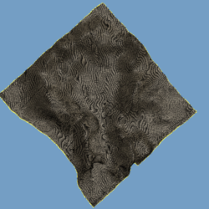
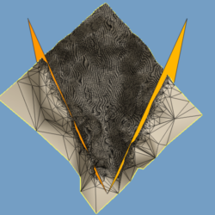
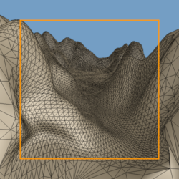
Application: Selective refinement
M⁰
vspl₀
vspl₁
vspl_{i-1}
vspl_{n-1}
(e.g. view frustum)
Notes:
Another application is selective refinement.
Sometimes it is desirable to refine the mesh only in selected regions.
For example, as a user flies over a dense terrain model, the mesh should be refined only within the user’s view frustum.
This can be achieved by applying to the base mesh only a selected subset of the vertex splits.
In this simple example, vertex splits were only applied if they modified the mesh within a given view frustum, show in orange.
<click><35mm> This slide shows a more complex example. Here vertex splits were performed based on 3 criteria: the view frustum, the projected size of faces, and the presence of silhouettes.
As a result, the mesh is refined more densely near the viewer and along ridge lines of the terrain.

Slide 19
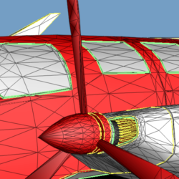
How to select edge collapses?
Preserve appearance:
geometric shape
scalar fields (e.g. color)
discontinuity curves
Σ
Σ
points
points
Notes:
I now return briefly to the issue of selecting edge collapses during simplification.
Recall that the goal of the simplification procedure is to preserve the appearance of the model.
This involves preserving its geometric shape, scalar fields such as color defined over its surface, and most importantly, discontinuity curves such as material boundaries and normal discontinuities.
These 3 goals are captured in an energy metric with 3 corresponding terms.
Ideally we would compute these integrals directly.
<click> But, we approximate them by discrete sampling, using a set of points sampled from the original mesh.
<click><35mm> These points are shown in the left picture.

Slide 20
Selecting edge collapses
Greedy algorithm: always collapse edge resulting in smallest Δ E
Simplification process
slow off-line process
could use simpler heuristics
Notes:
We use a greedy algorithm, which is to always collapse edges that result in the smallest increase in energy.
Some of the resulting errors are illustrated as line segments in the mesh on the right.
<click>
Using this optimization, we obtain simplification rates of about 30 faces per second.
This is quite slow, but the process can be performed off-line.
Also, we could instead use simpler heuristics for simplification. It’s a trade-off of accuracy vs. time.

Slide 21
Summary
^
M
PM
V
F
lossless
M⁰
vspl
single resolution
continuous-resolution
smooth LOD
space-efficient
progressive
Notes:
To summarize,
meshes are traditionally represented as a set of vertices and a set of faces.
In this talk I’ve shown that such meshes can be converted losslessly into a progressive mesh representation, composed of a base mesh and a sequence of vertex split records.
This new representation has a number of nice properties.
It captures a continuous-resolution family of approximations; it supports smooth level-of-detail; it is space-efficient; and, it can be transmitted progressively.
<click><35mm>(copy slide)
<click><video> I will conclude with some videos and a demo.
First video: This original mesh is a radiosity solution obtained using Lightscape. even with adaptive meshing, the mesh has over 150,000 faces…. PM: 6 geomorphs, from 1,500 faces up to 10,000 faces
This final example shows that progressive meshes can be used to represent images.

Slide 22
Demos

Slide 23
View-Dependent Refinement of Progressive Meshes
Hugues Hoppe

Slide 24
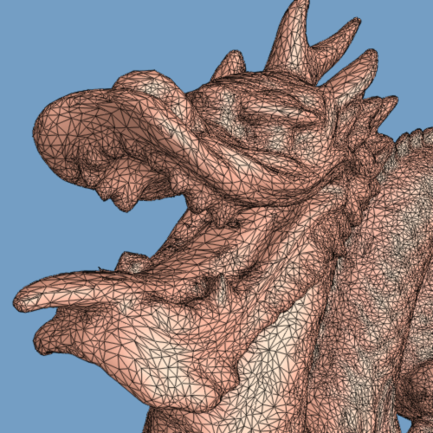
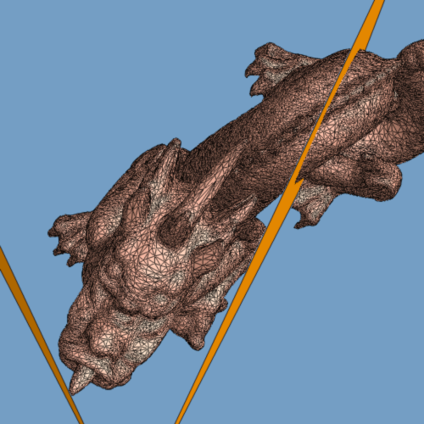
View-Independent LOD: Difficulties
distant
backfacing
outside view frustum
100,000 faces
Notes:
This presents difficulties with large-scale objects. For example, if we are looking at a close-up of the head of the dragon, we are required to use a relatively detailed mesh.
<click> The image on the right shows a top view of the same scene, where the view frustum is highlighted in orange. So these two orange planes correspond to the left and right sides of the image.
<click> As shown in this view, some parts of the model lie outside the view frustum; it is therefore unnecessary to render faces in these regions. These faces are typically sent to the graphics pipeline only to be discarded, and this processing incurs a cost.
<click> Similarly, some regions of the model face away from the viewer. If the object is closed, these regions do not need to be rendered. These backfacing faces are also discarded by the graphics pipeline through a process called backface culling, but again at a cost.
<click> Finally, some regions of the model lie much farther from the viewpoint than others. Ideally, we’d like to be able to adapt the level-of-detail over different parts of the surface.

Slide 25
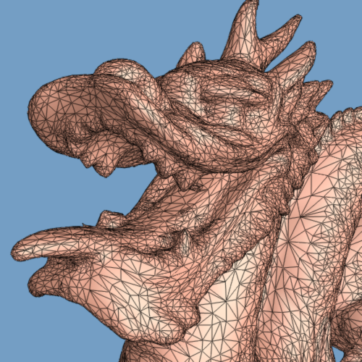
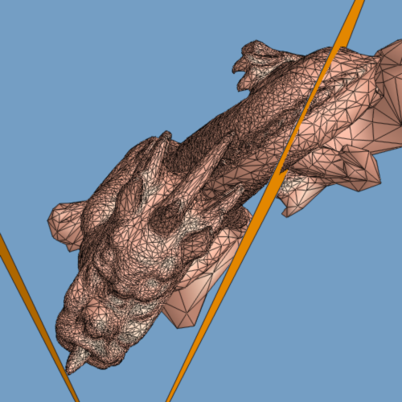
View-dependent LOD
29,400 faces
different LOD’s coexist over surface
Notes:
In this talk, I’ll present a scheme for achieving view-dependent LOD control. Different levels of detail can coexist over the same surface. Regions of the surface which are outside the view frustum, facing away, or distant, are appropriately coarsened, in order to improve rendering performance.
Furthermore, the scheme I’ll describe will be able to incrementally adapt the mesh as the view parameters change, in real-time.

Slide 26
Contributions
Progressive mesh → vertex hierarchy → selective refinement
Dependencies → consistent framework
View-dependent refinement criteria
Notes:
Here is an outline of the rest of the talk.
First, I’ll briefly review the progressive mesh representation. I’ll show that it naturally defines a vertex hierarchy, and that this hierarchy can be used to establish a selective refinement framework.
Next, I’ll introduce a set of dependencies that make this framework consistent.
Finally, I’ll present some criteria for determining where to refine and coarsen the mesh based on changing view parameters.

Slide 27
Review of progressive meshes
150
152
500
13,546
M⁰
M¹
… M¹⁷⁵ …
M^{n}
base mesh
original mesh
vertex split
v_{u}
v_{l}
v_{s}
v_{r}
v_{l}
v_{r}
v_{t}
edge collapse
Notes:
I’ll now briefly review the progressive mesh representation.
<4clicks> The basic idea is very simple; it is to simplify an arbitrary mesh through a sequence of transformations, down to a much simpler base mesh.
<click> The simplifying transformation is the edge collapse, which takes two adjacent vertices in the mesh, and unifies them into one vertex. In this example, the very last edge collapse removes the last window from the airplane.
<click> The edge collapse transformation is invertible; its inverse is called a vertex split; it takes a single vertex, and splits it into two vertices, thereby introducing two new faces.

Slide 28
Parent-child vertex relations
v_{s}
vsplit
v_{t}
v_{u}
Notes:
One of the keys to constructing a real-time framework is to recognize that the vertex split transformation defines a parent-child relation between the vertex that gets split and the resulting two vertices.

Slide 29
Vertex hierarchy
M⁰
vspl₀
vspl₀
vspl₁
vspl₁
vspl₂
vspl₂
vspl₃
vspl₃
vspl₄
vspl₄
vspl₅
PM:
vspl₅
M⁰
M⁰
v₁
v₁
v₂
v₂
v₃
v₃
v₁₀
v₁₀
v₁₁
v₄
v₅
v₅
v₈
v₉
v₁₂
v₁₃
v₆
M^{n}
v₆
v₇
v₁₄
v₁₅
Notes:
If we begin with the vertices of the base mesh M^0 and apply the vertex splits in order <6clicks>, we see that the parent-child vertex relations form a “forest” in which <click> the vertices of the base mesh are the root nodes, and <click> the vertices of the original, fully-refined mesh are the leaf nodes.
<click> A similar vertex hierarchy also appears in the work of [Xia & Varshney 96], except that it is built bottom-up. We construct our hierarchy top-down from an arbitrary progressive mesh, so our framework is somewhat more flexible.

Slide 30
Selective refinement
M⁰
vspl₀
vspl₀
vspl₁
vspl₁
vspl₂
vspl₂
vspl₃
vspl₃
vspl₄
vspl₂
vspl₄
vspl₅
M⁰
v₁
v₁
v₁
v₂
v₂
v₂
v₃
v₃
v₃
v₃
v₁₀
v₁₀
v₁₀
v₁₁
v₁₁
v₄
v₄
v₅
v₅
v₅
v₈
v₈
v₉
v₈
v₉
v₉
v₁₂
v₁₂
v₁₃
v₁₃
v₆
v₆
v₇
v₇
selectively refined mesh
v₁₄
v₁₅
Restrictions?
Notes:
Given this vertex hierarchy, we can think about applying both vertex splits and their inverses (edge collapses) selectively and out-of-sequence. <clicks>
<final click> Note that a selectively refined mesh corresponds to a vertex front through this vertex hierarchy, that is, a left-to-right cut.
<click> One question to ask is: are there any restrictions as to what vertex split and edge collapse transformations can be applied?

Slide 31
vspl/ecol restrictions
vsplit
f_{n1}
f_{n1}
v_{u}
f_{n3}
f_{n3}
v_{s}
f_{n0}
f_{n2}
f_{n0}
v_{t}
f_{n2}
ecol
vsplit legal if:
v_{s} is active
f_{n0},f_{n1},f_{n2},f_{n3} are active
ecol legal if:
v_{t},v_{u} are active
f_{n0},f_{n1},f_{n2},f_{n3} are adjacent
Notes:
I took an alternate route, which is to define a new parametrization for the vertex split and edge collapse transformations, which involves neighboring faces of the mesh.
<click> I define a vertex split to be legal if the center vertex v_s is active (that is, the vertex front passes through that vertex), and if the four faces f_n0, f_n1, f_n2, f_n3 expected by the vertex split are also all active.
Similarly, an edge collapse is legal if the two child vertices v_t and v_u are active (that is, the vertex front passes through two siblings), and if the four faces adjacent to the two faces to remove are the expected ones.

Slide 32
Runtime algorithm
M⁰
v₁
v₂
v₃
v₃
v₁₀
v₁₀
v₁₀
v₁₀
v₁₁
v₁₁
v₁₁
v₁₁
v₄
v₄
v₄
v₄
v₅
v₈
v₈
v₈
v₈
v₈
v₉
v₉
v₉
v₉
v₉
v₁₂
v₁₂
v₁₂
v₁₃
v₁₃
v₆
v₆
v₆
v₇
v₇
v₇
v₇
dependency
previous mesh
v₁₄
v₁₄
v₁₄
v₁₄
v₁₅
v₁₅
v₁₅
v₁₅
v₁₅
new mesh
Algorithm:
incremental (frame coherence)
efficient (~15% of frame time)
amortizable
Notes:
Here is how the runtime algorithm works. Prior to rendering, we start with the mesh from the previous frame. We traverse its active vertex front, and for each vertex, decided whether it should be refined or coarsened.
<click> <click> If we find that the region around a vertex should be coarsened and that the edge collapse is legal, we perform it.
<clicks> If we find that a vertex should be refined but that the vertex split is not legal because of a dependency, other vertex splits are performed in order to make the first vertex split legal.
<clicks> At the end of the traversal, we have a new mesh which we then render.
<click> Note that the algorithm exploits frame coherence since only incremental work is performed to adapt the mesh used in the previous frame.
We find that the algorithm is rather efficient; it requires only a small fraction of total frame time on a graphics workstation, because rendering has the same time complexity and is in fact the bottleneck.
Finally, this overhead can be further reduced by amortizing the algorithm over consecutive frames. <clicks> To achieve this, we consider at each time frame only a fraction of the active vertex list, as illustrated here.

Slide 33
View-dependent refinement criteria
3 criteria:
view frustum
surface orientation
screen-space geometric error
See paper for details.
Notes:
I define three criteria to adapt the refinement of the mesh based on the view parameters.
I will only present the intuition and show the results of these criteria; for the mathematical details please refer to the paper.

Slide 34
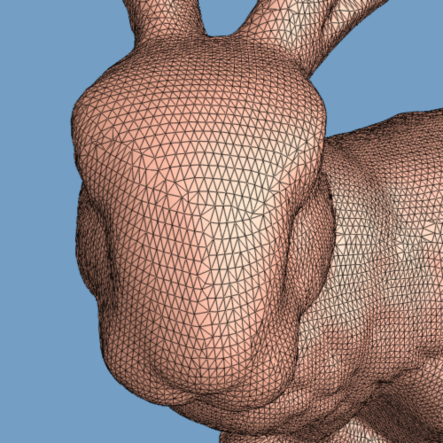
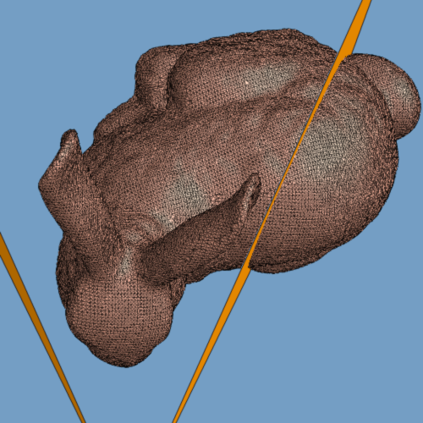
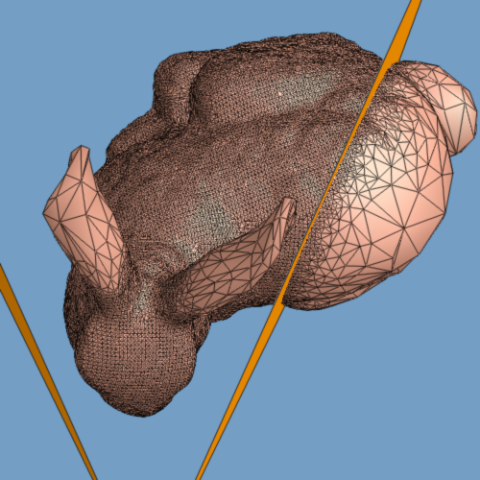
(1) View frustum
view is unchanged
too high
too far right
Notes:
The view frustum criterion acts to coarsen regions of the mesh outside the view frustum.
Basically, it refines a vertex only if the region of the surface affected by the refinement overlaps with the view frustum. This is determined using a bounding sphere hierarchy.
The criterion is conservative, so the view within the frustum is left unchanged.

Slide 35
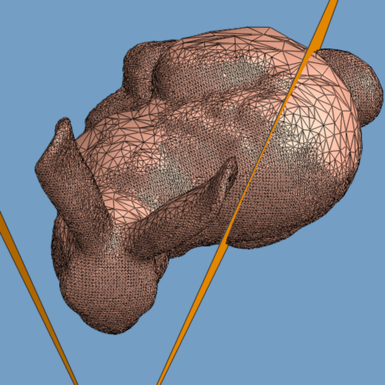
(2) Surface orientation
view is unchanged
oriented away
Notes:
The surface orientation criterion acts to coarsen regions of the mesh oriented away from the viewer.
It is very similar to the view frustum criterion, but instead of considering the extent of the surface region affected by a refinement, we consider the space of normals over that region. For this we make use of a normal space hierarchy, using cones of normals.
Again, this criterion is conservative so that the visible portion of the model is unchanged.

Slide 36
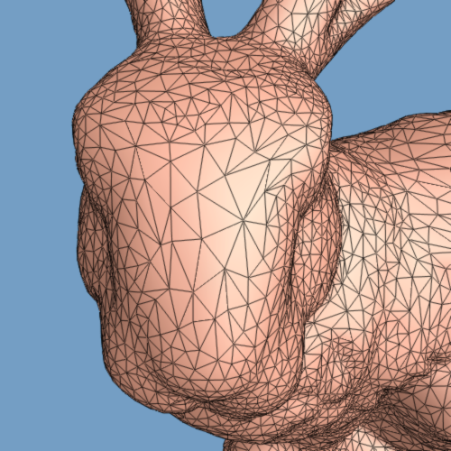
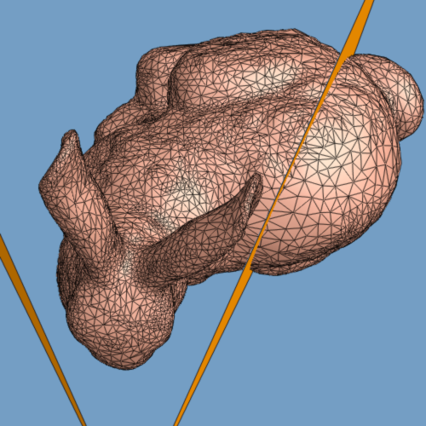
(3) Screen-space geometric error
tolerance=0.5 pixels
refinement near silhouette
coarser in distance
Notes:
The third refinement criterion adapts the mesh refinement so that the deviation of the approximating mesh, when projected on the screen, is everywhere less than a screen-space error tolerance.
In this example, the tolerance is set to 0.5 pixels (the images are 500x500 pixels).
One natural byproduct of this criterion is that the refinement is denser near the object’s silhouettes where the deviation of the surface is perpendicular to the viewing direction.
Also, the mesh is made coarser the farther it is from the viewpoint.

Slide 37

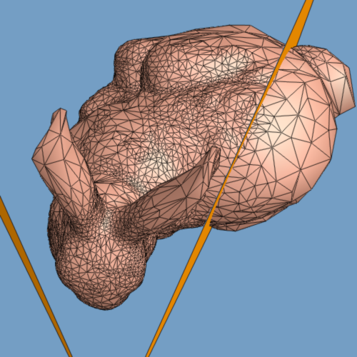
All three criteria together
69,473 faces → 10,528 faces
Notes:
This pair of images shows the result of applying all 3 criteria together.
The fully refined mesh of 70,000 faces is simplified to about 10,000 faces. Interactive frame rate is thereby increased from about 2 to 7 frames/sec. This includes the time taken for adaptive refinement, which is only a small fraction of rendering time.

Slide 38
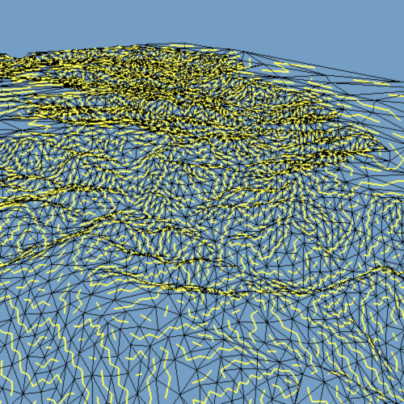
Fast rendering: triangle strips
Greedy algorithm:
IRIS GL: avg. 10-15 faces/strip
OpenGL: avg. 4.2 faces/strip
Notes:
One technique for improving rendering performance is to send faces down the graphics pipeline in triangle strips.
Typically, triangle strips are constructed in a preprocess. However, with selective refinement, the mesh connectivity is dynamic.
We have found that, surprisingly, we can generate such strips every frame using a simple greedy algorithm, with pretty good performance.
With IRIS GL, the generalized triangle strips average 10 to 15 faces per strip.
With the more restricted sequential strips of OpenGL, the strips average about 4.2 faces per strip, as shown in this example. But in fact this is sufficient to improve rendering speed.

Slide 39
Geomorphs
smooth visual transitions
Notes:
Another nice property of the selective refinement framework is that we can form a geomorph, or smooth visual transition, between any two selectively refined meshes.
So given two meshes M^A and M^B, we can find a new mesh M^G whose vertex front is everywhere lower than or equal to M^A and M^B. Such a mesh M^G has the property that, as we interpolate its vertices, it can smoothly transition between M^A and M^B.
This type of geomorph will be demonstrated in the video.

Slide 40
Summary
Selective refinement framework
View-dependent refinement criteria
Real-time algorithm (fast, amortizable)
Arbitrary progressive meshes → geometrically optimized refinement!
Notes:
To summarize, we have introduced a selective refinement framework using progressive meshes.
We have introduced refinement criteria for adapting the resolution of the mesh according to changing view parameters,
and presented a real-time algorithm for incrementally updating the mesh. The algorithm is extremely fast; it consumes only 15% of total frame time on a graphics workstation. In addition, the algorithm can be amortized over successive frames.
Because the refinement framework is constructed using arbitrary progressive meshes, the refinement operations are geometrically optimized and therefore quickly recover the model’s geometry.

Slide 41
Demo

Slide 42
Dynamic View-Dependent Simplification for Polygonal Models
Julie C. Xia
Amitabh Varshney

Slide 43
Real-Time Update
Keep a vertex frontier and active face list
Update the frontier based on error
Local illumination
Based on normal and lighting conditions
Screen space projection
Projected edge lengths
Visibility culling
Use frustum
Silhouette boundaries
Again, screen space projected lengths

Slide 44
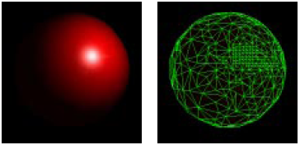
Adaptive LOD
Uniform LOD
Adaptive LOD

Slide 45
Later work
Memory management for large models
Animated models
GPU-friendly algorithms
E.g., http://felixpalmer.github.io/lod-terrain/
Notes:
I’ll quickly mention some areas for future work.
For large models, particularly terrains, memory management becomes an issue.
Although I demonstrated geomorphs, the current real-time prototype does not make use of geomorphs; it would be interesting to generate geomorphs at runtime.
The current refinement criteria only account for the geometry of the surface. These criteria should be extended to also account for the shading of the surface.
Finally, I have only considered static meshes. It would be interesting to extend this framework to handle animated or deforming models.

Slide 46
Acknowledgements
Slides from Hoppe
Figures from Xia and Varshney

